Slide 1
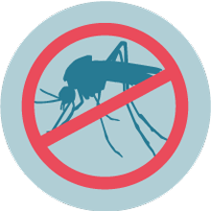
Prediction of mosquitos with West Nile Virus
02/11/2022 Hanpu Yao
MUSA capstone

Slide 2
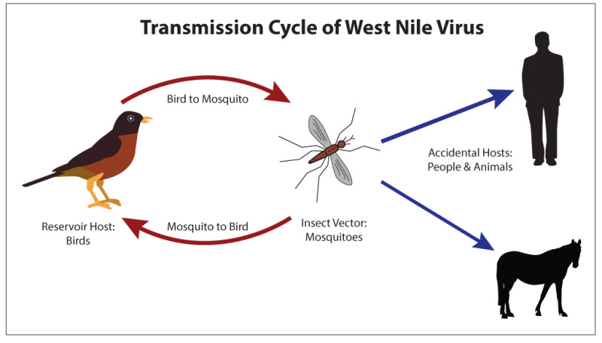
What is West Nile virus (WNV)
is the leading cause of mosquito-borne disease in U.S.
spread to people by the bite of an infected mosquito

Slide 3
Research question
Scale: City of Chicago
Goal: Predict a probability that WNV is present

Slide 4
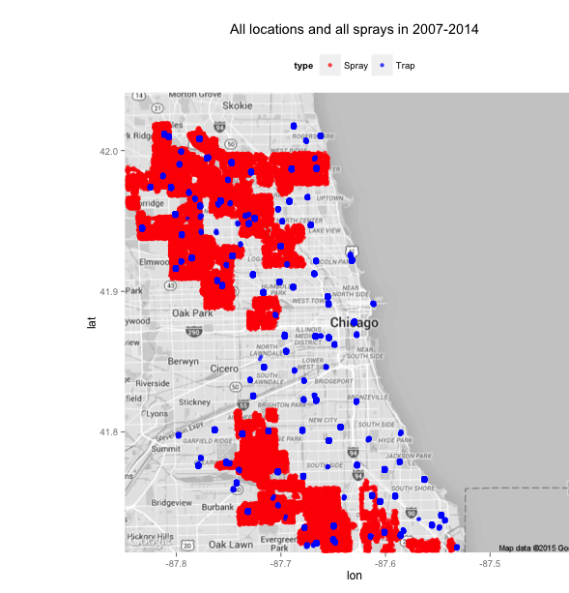
Datasets
Main data: mosquitos in traps
Time
Location
Mosquitoes:
numbers
Species
Whether or not WNV is present
Spray Data: spraying efforts to kill mosquitos
Time
Location

Slide 5
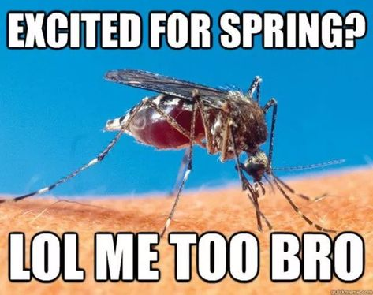
Datasets
Weather Data – WNV prefers hot and dry environment
Rain
Wind
Temperature
…

Slide 6
Datasets – to be collected
Bird
Qualitative
Migratory behavior
Quantitative
Time
Location
Species size
Urban environment - 311
Sanitation
Natural environment
Parks
Lakes

Slide 7
Methods
Data Processing
Lag (temporal and spatial)
Distance to parks, lakes, bird habitats…
Model
Random forest Regression & Classification
XGBoost

Slide 8
Limitation
Data sample bias
Trap locations
Collecting Time
Urban environment changes
Potential pesticide resistance

Slide 9
Next Steps
Get more datasets and clean them
Compare regression and classification models

